Slide 1
HEAP SORT

Slide 2
SPECIAL TYPES OF TREES
Def: Full binary tree = a binary tree in which each node is either a leaf or has degree exactly 2.
Def: Complete binary tree = A binary tree T with n levels is Complete if all levels except possibly the last are completely full, and the last level has all its nodes to the left side.
4
1
3
2
16
9
10
14
8
7
12
Full binary tree
4
1
3
2
16
Complete binary tree

Slide 3
THE HEAP DATA STRUCTURE
Def: A heap is a nearly complete binary tree with the following two properties:
  Structural property: all levels are full, except possibly the last one, which is filled from left to right
  Order (heap) property: for any node x
  Parent(x) ≥ x
From the heap property, it follows that:
“The root is the maximum
element of the heap!”
8
7
4
5
2
Heap
A heap is a binary tree that is filled in order

Slide 4
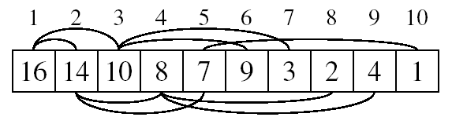
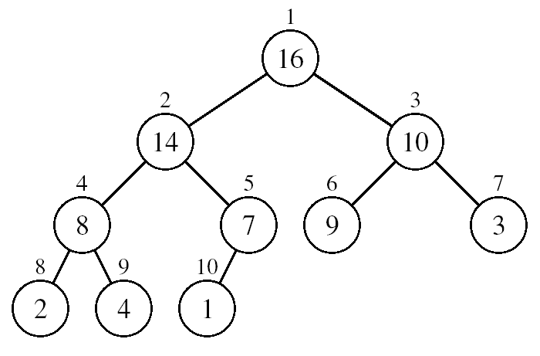
ARRAY REPRESENTATION OF HEAPS
A heap can be stored as an array A.
  Root of tree is A[1]
  Left child of A[i] = A[2i]
  Right child of A[i] = A[2i + 1]
  Parent of A[i] = A[ ⎣i/2⎦ ]
  Heapsize[A] ≤ length[A]
The elements in the subarray A[(⎣n/2⎦+1) .. n] are leaves.
Here n=10 so 6 to 10 are leaves.

Slide 5
HEAP TYPES
Max-heaps (largest element at root), have the max-heap property:
  for all nodes i, excluding the root:
  A[PARENT(i)] ≥ A[i]
Min-heaps (smallest element at root), have the min-heap property:
  for all nodes i, excluding the root:
  A[PARENT(i)] ≤ A[i]

Slide 6
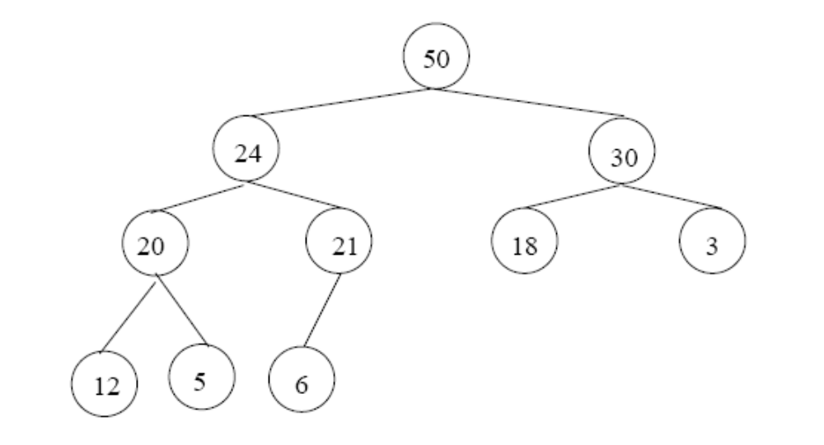
ADDING/DELETING NODES
New nodes are always inserted at the bottom level (left to right)
Nodes are removed from the bottom level (right to left)

Slide 7
OPERATIONS ON HEAPS
Maintain/Restore the max-heap property
  MAX-HEAPIFY
Create a max-heap from an unordered array
  BUILD-MAX-HEAP
Sort an array in place
  HEAPSORT

Slide 8
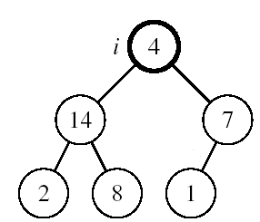
MAINTAINING THE HEAP PROPERTY
Suppose a node is smaller than a child
  Left and Right subtrees of i are max-heaps
To eliminate the violation:
  Exchange with larger child
  Move down the tree
  Continue until node is not smaller than children

Slide 9
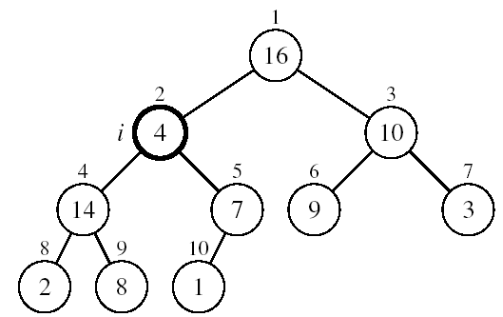
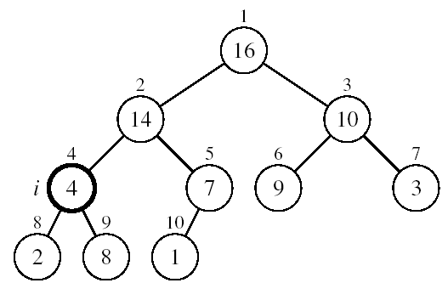
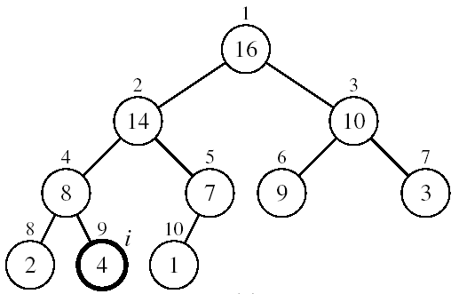
EXAMPLE
MAX-HEAPIFY(A, 2, 10)
A[2] ↔ A[4]
A[2] violates the heap property
A[4] violates the heap property
A[4] ↔ A[9]
Heap property restored

Slide 10
MAINTAINING THE HEAP PROPERTY
Alg: MAX-HEAPIFY(A, i, n)
l ← LEFT(i)
r ← RIGHT(i)
if l ≤ n and A[l] > A[i]
then largest ←l
else largest ←i
if r ≤ n and A[r] > A[largest]
then largest ←r
if largest ≠ i
then exchange A[i] ↔ A[largest]
MAX-HEAPIFY(A, largest, n)
Assumptions:
  Left and Right subtrees of i are max-heaps
  A[i] may be smaller than its children

Slide 11
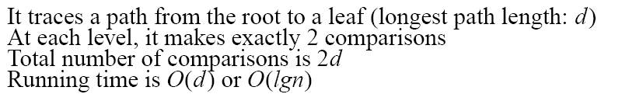
MAX-HEAPIFY RUNNING TIME
Intuitively:
Running time of MAX-HEAPIFY is O(lgn)
Can be written in terms of the height of the heap, as being O(h)
  Since the height of the heap is ⎣lgn⎦
-
h
-
-
-
2h
O(h)

Slide 12
BUILDING A HEAP
Convert an array A[1 … n] into a max-heap (n = length[A])
The elements in the subarray A[(⎣n/2⎦+1) .. n] are leaves
Apply MAX-HEAPIFY on elements between 1 and ⎣n/2⎦
Alg: BUILD-MAX-HEAP(A)
n = length[A]
for i ← ⎣n/2⎦ downto 1
do MAX-HEAPIFY(A, i, n)
1
4
2
3
1
3
4
5
6
7
2
16
9
10
8
9
10
14
8
7
A:
4 | 1 | 3 | 2 | 16 | 9 | 10 | 14 | 8 | 7

Slide 13
EXAMPLE: A
4 | 1 | 3 | 2 | 16 | 9 | 10 | 14 | 8 | 7
i = 5
i = 4
i = 3
1
1
1
4
4
4
2
3
2
3
2
3
1
3
1
3
1
3
4
5
6
7
4
5
6
7
4
5
6
7
2
16
9
10
2
16
9
10
14
16
9
10
8
9
10
8
9
10
8
9
10
14
8
7
14
8
7
2
8
7
i = 2
i = 1
1
1
1
4
4
16
2
3
2
3
2
3
1
10
16
10
14
10
4
5
6
7
4
5
6
7
4
5
6
7
14
16
9
3
14
7
9
3
8
7
9
3
8
9
10
8
9
10
8
9
10
2
8
7
2
8
1
2
4
1

Slide 14
RUNNING TIME OF BUILD MAX HEAP
Alg: BUILD-MAX-HEAP(A)
n = length[A]
for i ← ⎣n/2⎦ downto 1
do MAX-HEAPIFY(A, i, n)
O(n)
O(lgn)
⇒ Running time: O(nlgn)

Slide 15
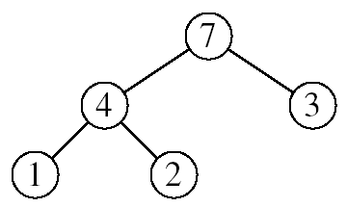
HEAPSORT
Goal:
  Sort an array using heap representations
Idea:
  Build a max-heap from the array
  Swap the root (the maximum element) with the last element in the array
  “Discard” this last node by decreasing the heap size
  Call MAX-HEAPIFY on the new root
  Repeat this process until only one node remains

Slide 16
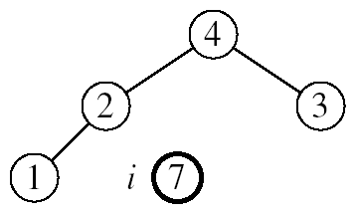
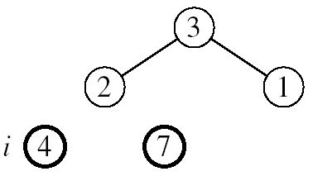
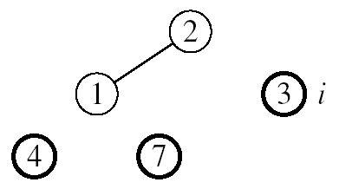
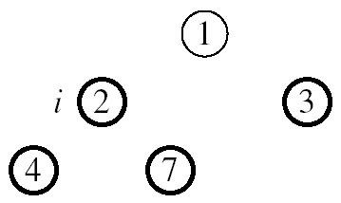

EXAMPLE: A=[7, 4, 3, 1, 2]
MAX-HEAPIFY(A, 1, 4)
MAX-HEAPIFY(A, 1, 3)
MAX-HEAPIFY(A, 1, 2)
MAX-HEAPIFY(A, 1, 1)

Slide 17
ALG: HEAPSORT(A)
BUILD-MAX-HEAP(A)
for i ← length[A] downto 2
do exchange A[1] ↔ A[i]
MAX-HEAPIFY(A, 1, i - 1)
Running time: O(nlgn)
O(n)
n-1 times
O(lgn)

Slide 18
SUMMARY
We can perform the following operations on heaps:
  MAX-HEAPIFY O(lgn)
  BUILD-MAX-HEAP O(n)
  HEAP-SORT O(nlgn)
  MAX-HEAP-INSERT O(lgn)
  HEAP-EXTRACT-MAX O(lgn)
  HEAP-INCREASE-KEY O(lgn)
  HEAP-MAXIMUM O(1)
Average
O(lgn)

Slide 19
PROBLEMS
Assuming the data in a max-heap are distinct, what are the possible locations of the second-largest element?

Slide 20
PROBLEMS
(a) What is the maximum number of nodes in a max heap of height h?
(b) What is the maximum number of leaves?
(c) What is the maximum number of internal nodes?

Slide 21
PROBLEMS
Demonstrate, step by step, the operation of Build-Heap on the array
A=[5, 3, 17, 10, 84, 19, 6, 22, 9]

